Slide 1
Temporal Variability in Low-Frequency Radio Interference: Insight from High-Cadence Monitoring at a Candidate Radio Notification Zone in Malaysia
Affan Adly Nazri – Ph.D. Candidate, RCL-UM
5th UM-NARIT Bilateral Symposium, Chiang Mai, Thailand

Slide 2
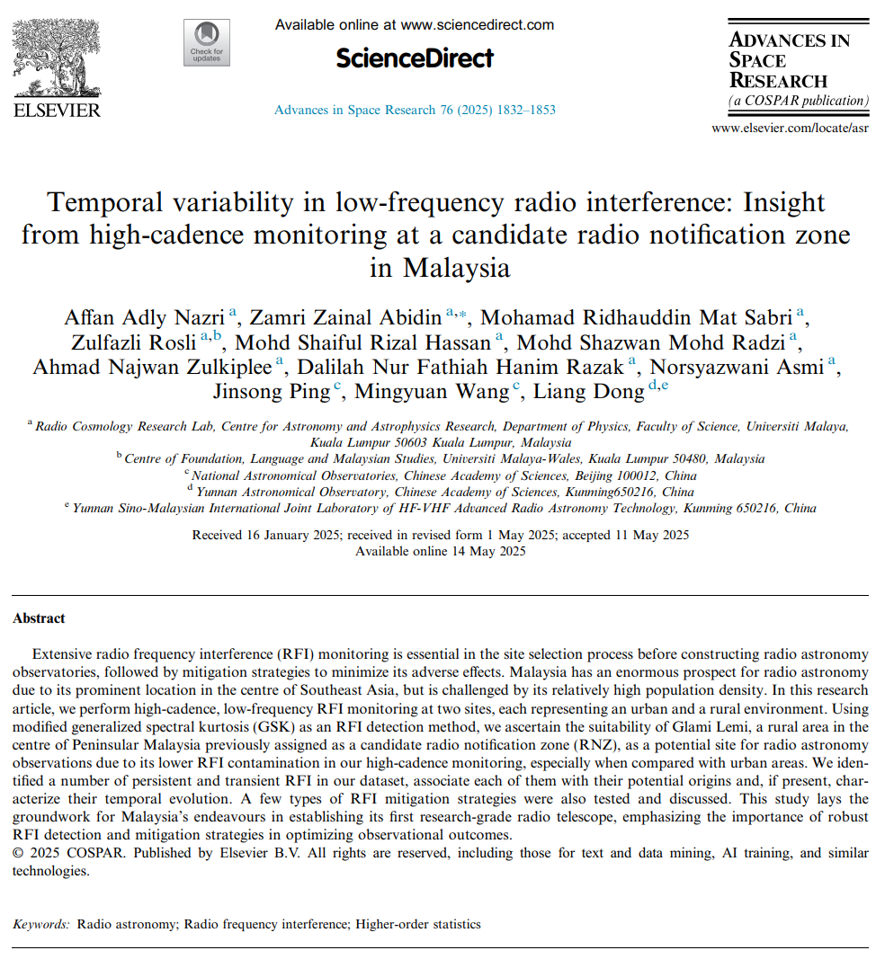

Malaysia RFI Review
Objective
Methodology
Results
Discussion
Summary
arxiv.org/abs/2505.19372
Notes:
Paper was published a couple months ago on Advances in Space Research, but not open access, can go to the arxiv link shown
Not going to introduce about RFI, based on previous presentations, NARIT team is very well-versed in the topic

Slide 3
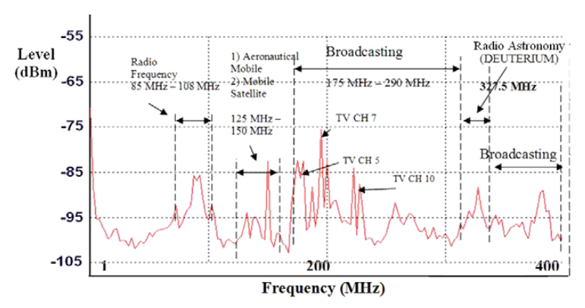
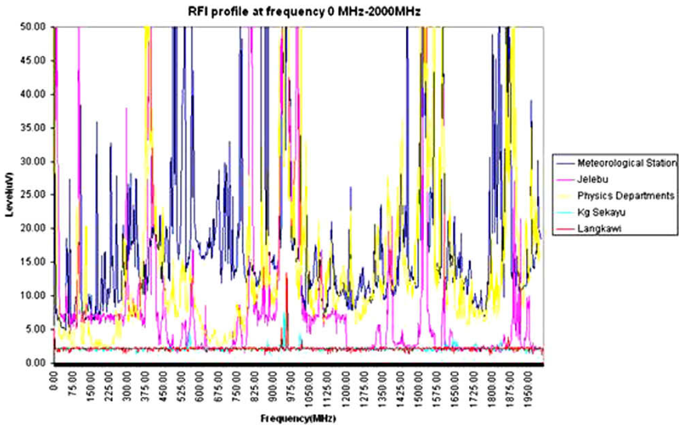
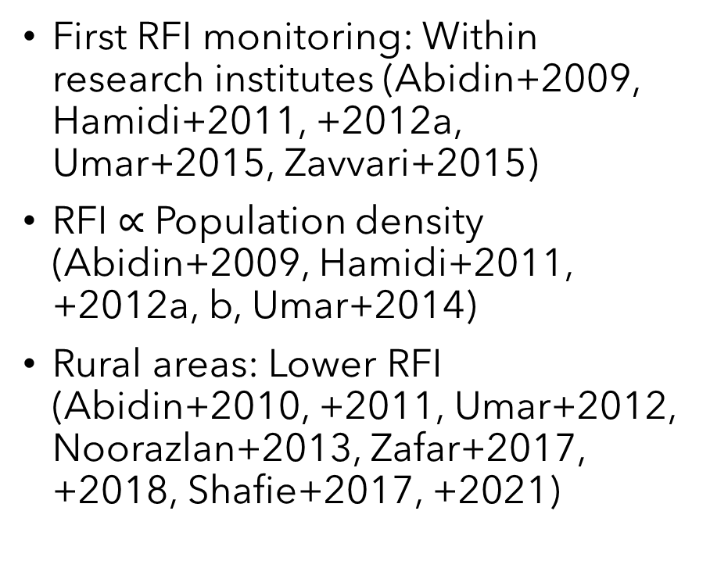
Malaysia RFI Review
First RFI monitoring: Within research institutes (Abidin+2009, Hamidi+2011, +2012a, Umar+2015, Zavvari+2015)
RFI $∝$ Population density (Abidin+2009, Hamidi+2011, +2012a, b, Umar+2014)
Rural areas: Lower RFI (Abidin+2010, +2011, Umar+2012, Noorazlan+2013, Zafar+2017, +2018, Shafie+2017, +2021)
Top: RFI profile in Universiti Malaya between 0 – 400 MHz. Source: Abidin+2009. Bottom: RFI profile in various locations in Malaysia. Source: Abidin+2010.
Notes:
RFI monitoring began as pilot project to establish radio astronomy in Malaysia, so performed at research institutes: Institutes located in dense urban areas, strong RFI as expected from mobile telco, radio and TV broadcast, and satellite
Some researchers characterized the clear correlation between population density and RFI levels, mainly due to dense telco at around 1000 and 1800 MHz
Then look at rural areas (population density less than 150/km^2): Clear drop in RFI levels except in satellite bands
Narrow band results in multiple radio astronomy windows are mixed, sometimes RFI-free, sometimes contaminated by sidebands/neighbouring channels

Slide 4
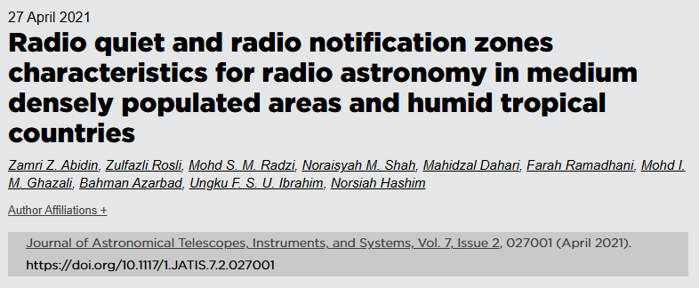
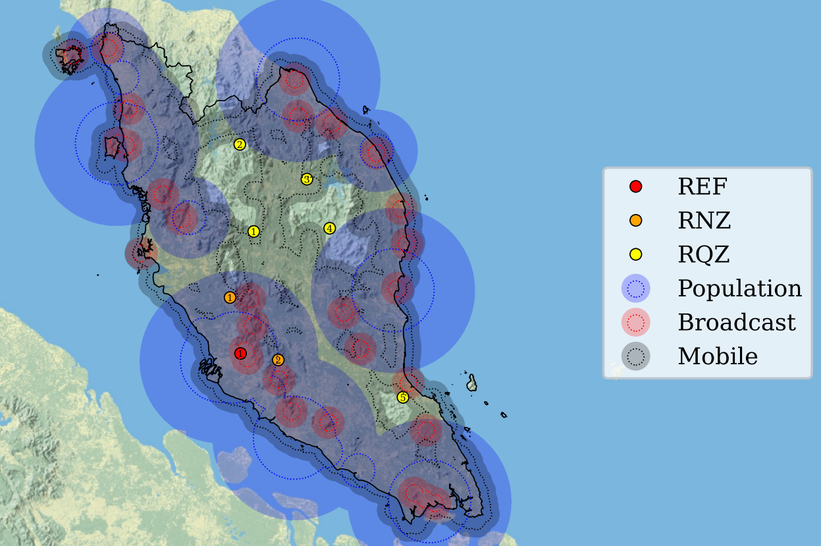
Malaysia RFI Review
Most comprehensive RFI study: Abidin+2021
List candidate RQZ/RNZ using minimum weightage: Humidity, population density, distance from telco/broadcast
RFI measurements over 24 hours (0 – 4 GHz)
Lowest average noise: Kuala Tembeling (RQZ) and Jelebu (RNZ)
Identification of RNZ and RQZ candidates in Peninsular Malaysia as described in Abidin+2021. The red, orange, and yellow points indicate the locations of reference (1: Universiti Malaya), candidate RNZ (1: Universiti Pendidikan Sultan Idris, 2: Jelebu), and candidate RQZ (1: Kuala Medang, 2: Grik, 3: Gua Musang, 4: Kuala Tembeling, 5: Selendang) sites respectively.
Notes:
Suggest RQZ and RNZ locations in Malaysia
List potential locations based on humidity/rainfall, population density, distance from telco and broadcast stations: Using minimum weightage method (shown in map)
Perform RFI measurements at candidates up to 4 GHz: Average noise all below ITU recommendation for radio astronomy

Slide 5
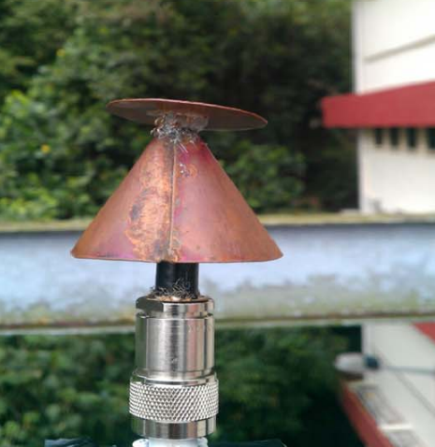
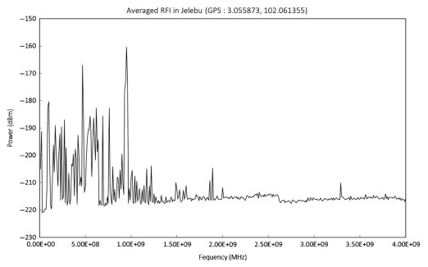
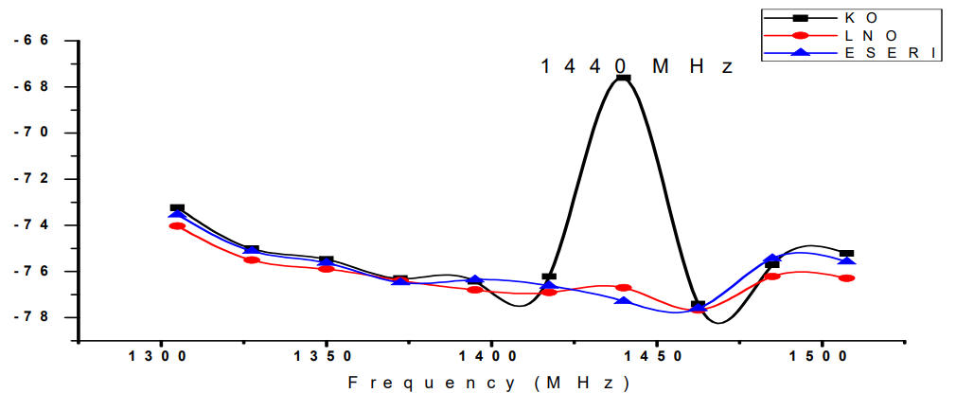

Malaysia RFI Review
Limitations of previous studies
Wide frequency range = Large band separations
Narrow band measurements target $f>f_{VHF}$
Basic and small antennas, low sensitivity
Averaged data over large cadence
Minimal statistics
Top right: Simple discone antenna used for most of the RFI measurements. Source: Umar+2013. Bottom right: Wide frequency range RFI measurement performed in Jelebu up to 4 GHz. Source: Abidin+2021. Bottom left: Narrow band RFI measurement targetting the HI line. Source: Zafar+2017.
Notes:
Most of the observations cover wide frequency ranges of up to 4 GHz: Large band separation, narrow band RFI loss
Narrow band measurements target above VHF
Basic antennas means lower sensitivity
RFI measurements done over large cadences and averaged: No info about time-dependence
Minimal to no statistical evaluations used to detect RFI

Slide 6
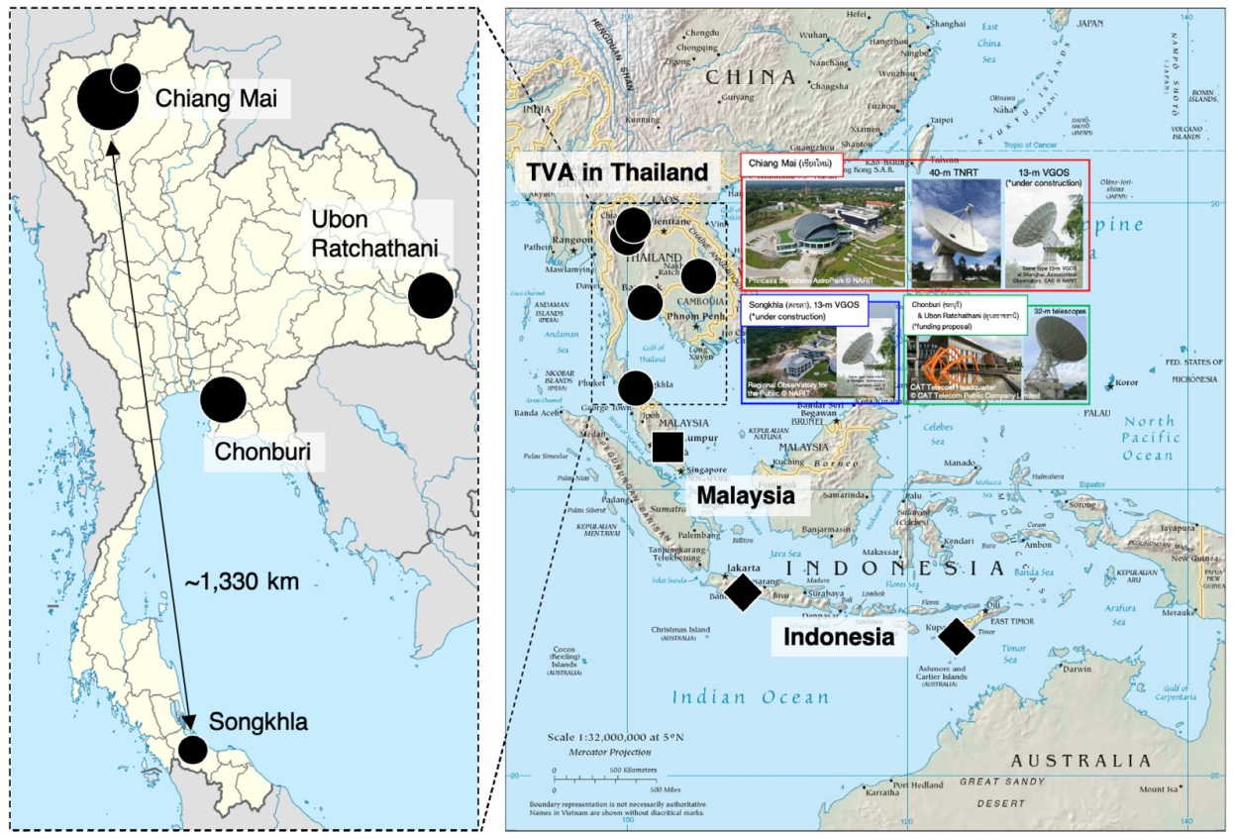
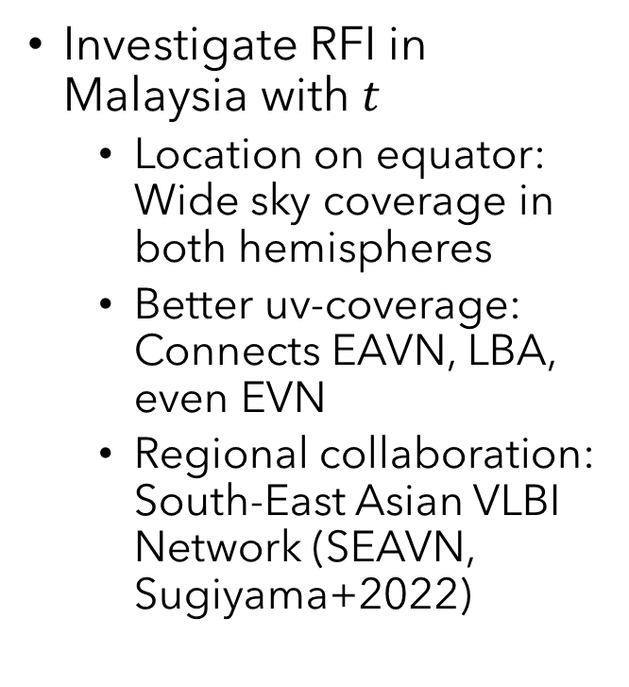
Objective
Investigate RFI in Malaysia with $t$
Location on equator: Wide sky coverage in both hemispheres
Better uv-coverage: Connects EAVN, LBA, even EVN
Regional collaboration: South-East Asian VLBI Network (SEAVN, Sugiyama+2022)
Distribution of telescopes in the tentative Thai National VLBI Array and its position within the prospective South-East Asian VLBI Network, including the upcoming telescope in Jelebu. Source: Sugiyama+2022.
Notes:
Main objective: Investigate the low frequency RFI dependence with time in Malaysia to survey our prospects of conducting radio astronomy in the country
Location close to the equator: Wide sky coverage to cover both the Northern and Southern celestial hemisphere, with little seasonal limitations
Central location would allow us to connect VLBI arrays like the EAVN and the LBA, and even the EVN: Achieve better uv-coverage and higher sensitivity
Ultimately, we would like to develop our goal of regional collaboration by establishing the South-East Asian VLBI Network (SEAVN), connecting Malaysia, Thailand, Indonesia, and Vietnam

Slide 7
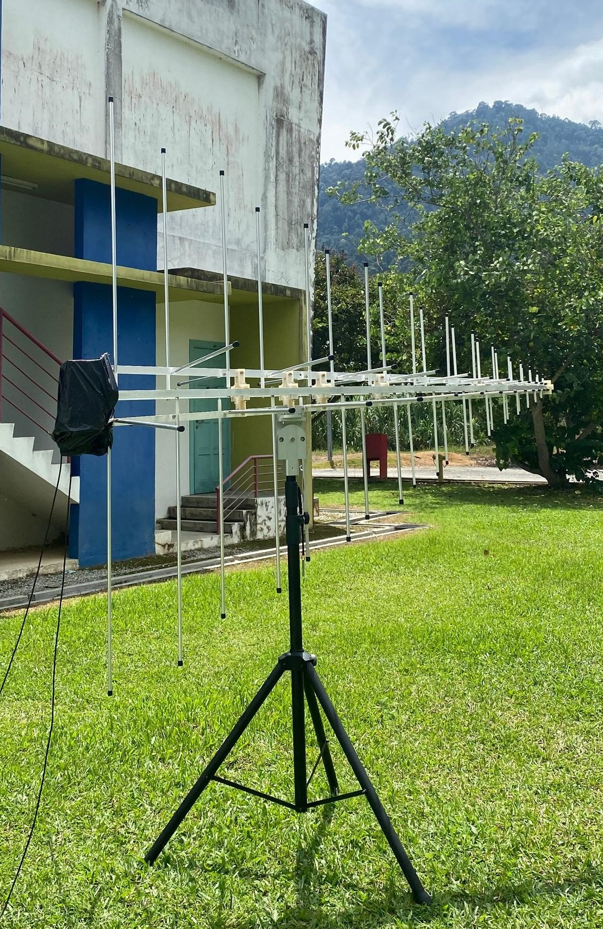
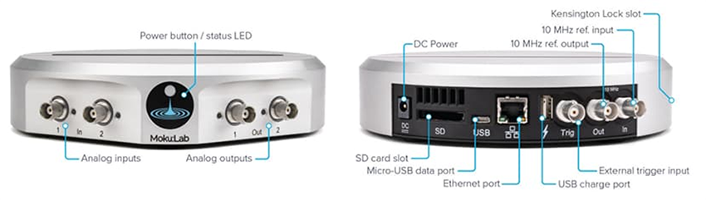
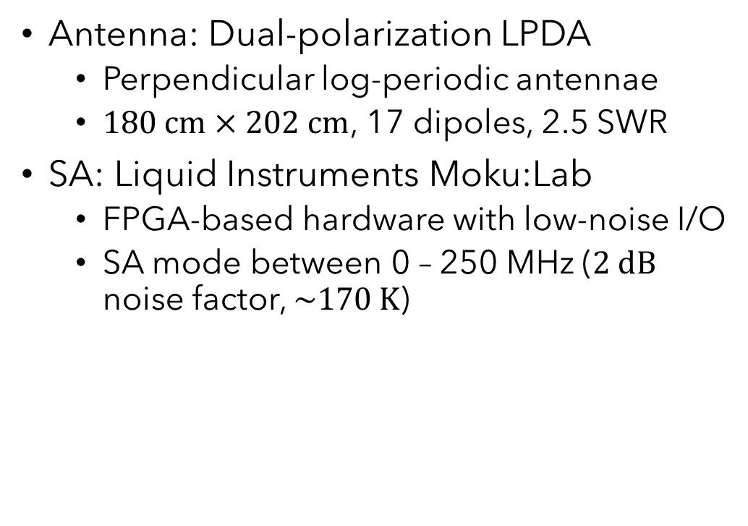
Methodology
Antenna: Dual-polarization LPDA
Perpendicular log-periodic antennae
$180 cm×202 cm$, 17 dipoles, 2.5 SWR
SA: Liquid Instruments Moku:Lab
FPGA-based hardware with low-noise I/O
SA mode between 0 – 250 MHz ($2 dB$ noise factor, $\sim 170 K$)
Right: LPDA used for RFI measurements. Left: Liquid Instruments Moku:Lab.
Notes:
We target the frequency range of 0 – 250 MHz, with 1023 frequency channels and a frequency spacing of about 240 kHz

Slide 8
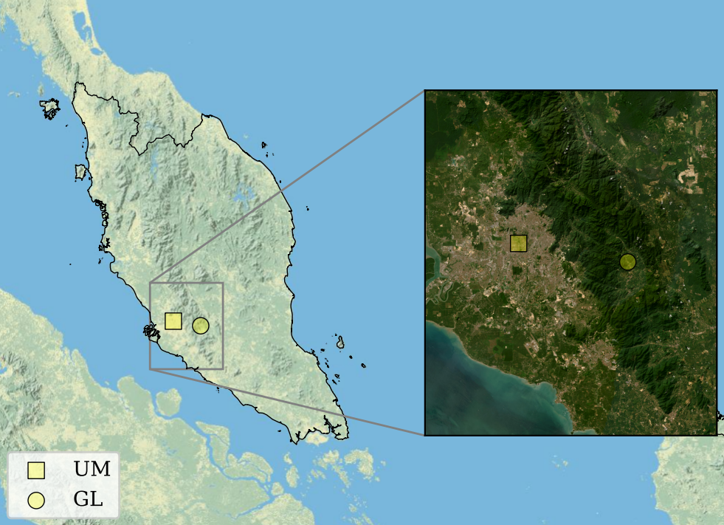
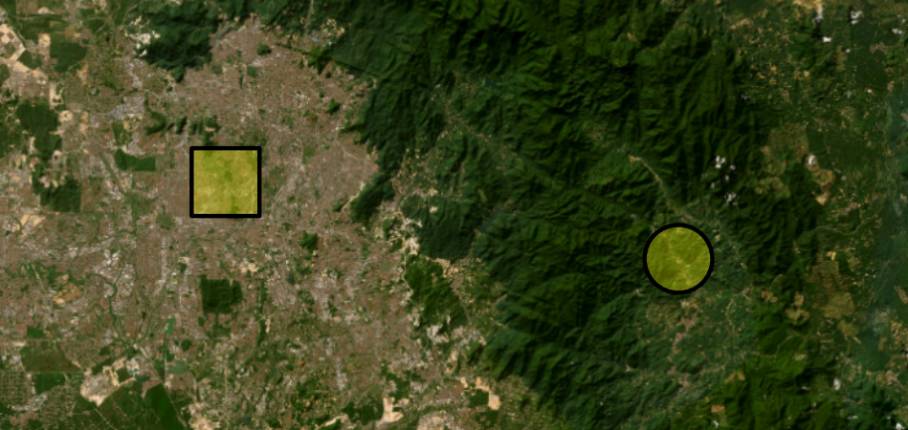
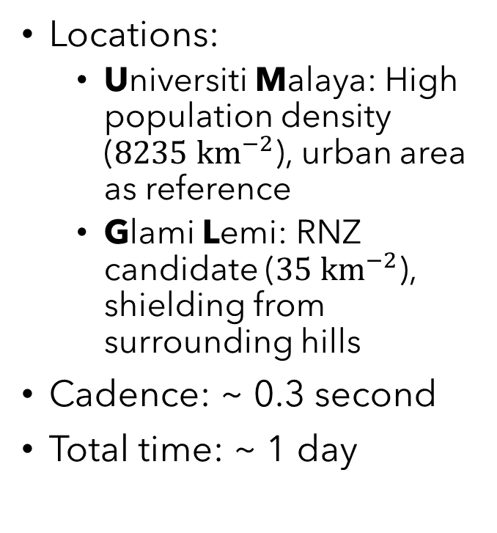
Methodology
Locations:
Universiti Malaya: High population density ($8235 {km}^{−2}$), urban area as reference
Glami Lemi: RNZ candidate ($35 {km}^{−2}$), shielding from surrounding hills
Cadence: ~ 0.3 second
Total time: ~ 1 day
Location of the two RFI monitoring sites
Notes:
UM represents an urban area with a very high population density which we use as a baseline reference
GL is the Glami Lemi Biotechnology Research Center, Jelebu, Negeri Sembilan, which was denoted as an RNZ candidate due to its low average rainfall and humidity, as well as shielding from the surrounding hills *** as shown

Slide 9
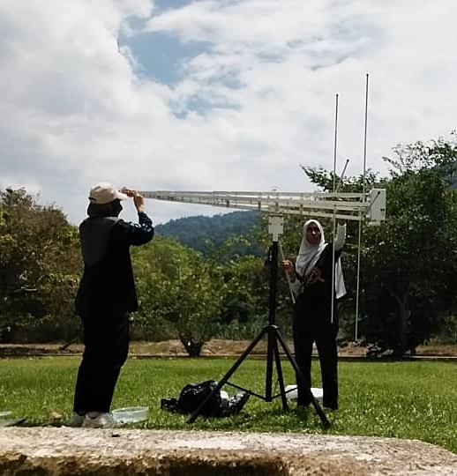
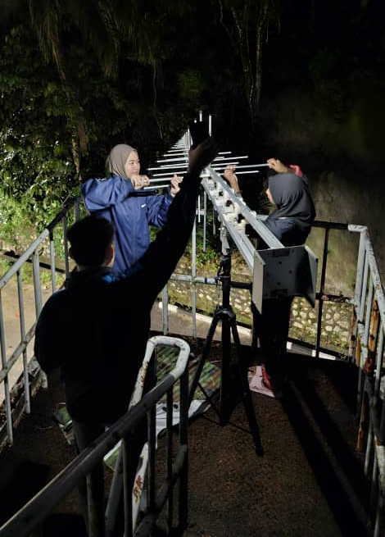
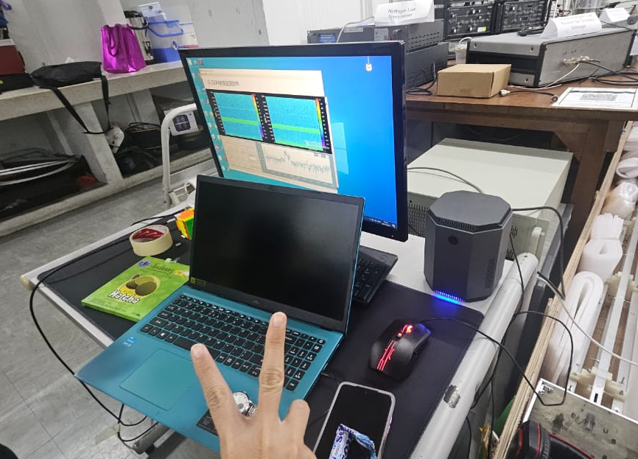
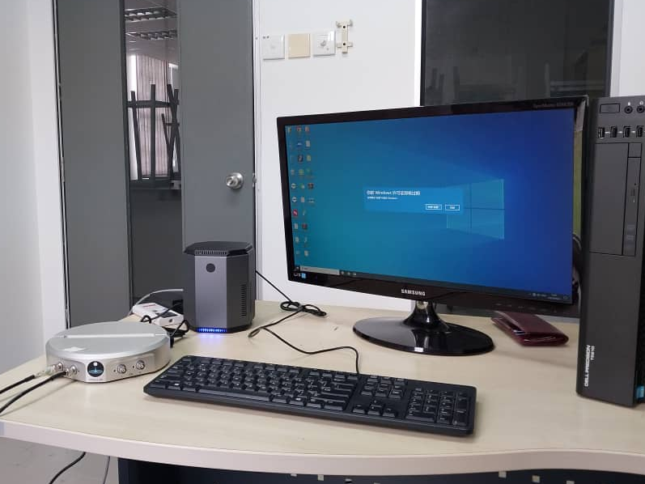
Methodology
Photos during the UM and GL RFI monitoring sessions.

Slide 10
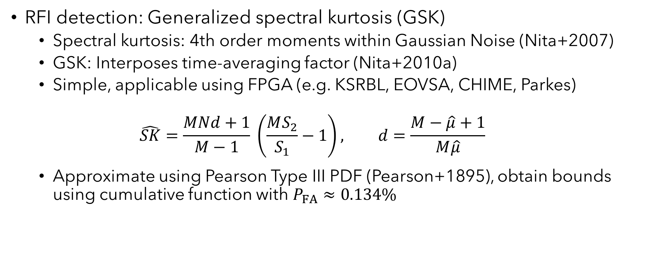
Methodology
RFI detection: Generalized spectral kurtosis (GSK)
Spectral kurtosis: 4th order moments within Gaussian Noise (Nita+2007)
GSK: Interposes time-averaging factor (Nita+2010a)
Simple, applicable using FPGA (e.g. KSRBL, EOVSA, CHIME, Parkes)
$$\hat{SK}=\frac{MNd+1}{M−1} \left(\frac{MS_{2}}{S_{1}}−1\right), d=\frac{M−\hat{μ}+1}{M\hat{μ}}$$
Approximate using Pearson Type III PDF (Pearson+1895), obtain bounds using cumulative function with $P_{FA}≈0.134\%$
Notes:
SK utilizes fourth order moments in the data to detect RFI within Gaussian noise
Generalized spectral kurtosis (GSK) the includes the time-averaging factor so that the algorithm works with standard correlators
Can be applied in instruments’ FPGA backends, and it has been seen to be effective various instruments
This the GSK estimator, and the shape factor, d is what determines how skewed the noise is
Traditionally the shape factor depends on the mean SK value, but here we use the median to try to reduce the effects of very strong RFI
The distribution is then approximated using the Pearson Type II PDF, and the bounds for the cumulative function is set to a false alarm probability of 0.134%, which corresponds to the usual 3-sigma

Slide 11
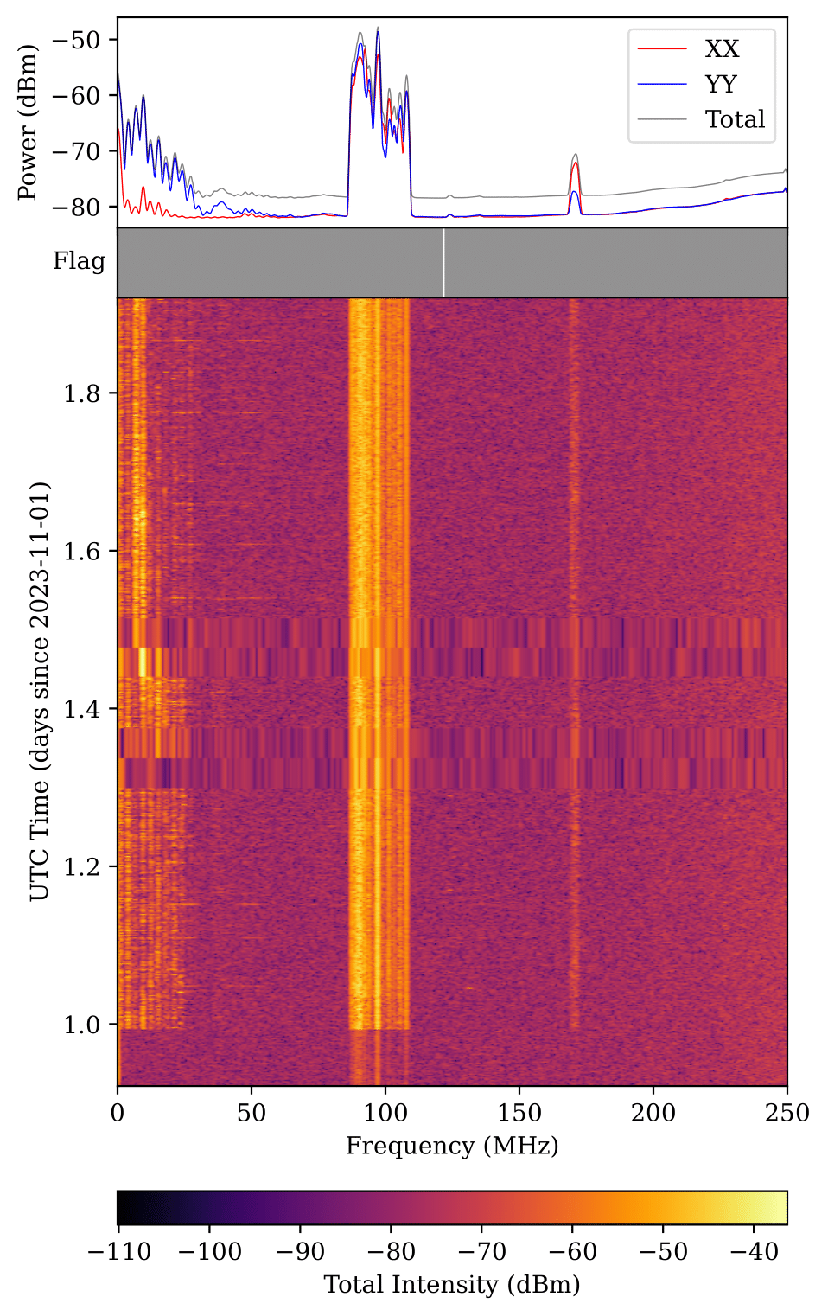
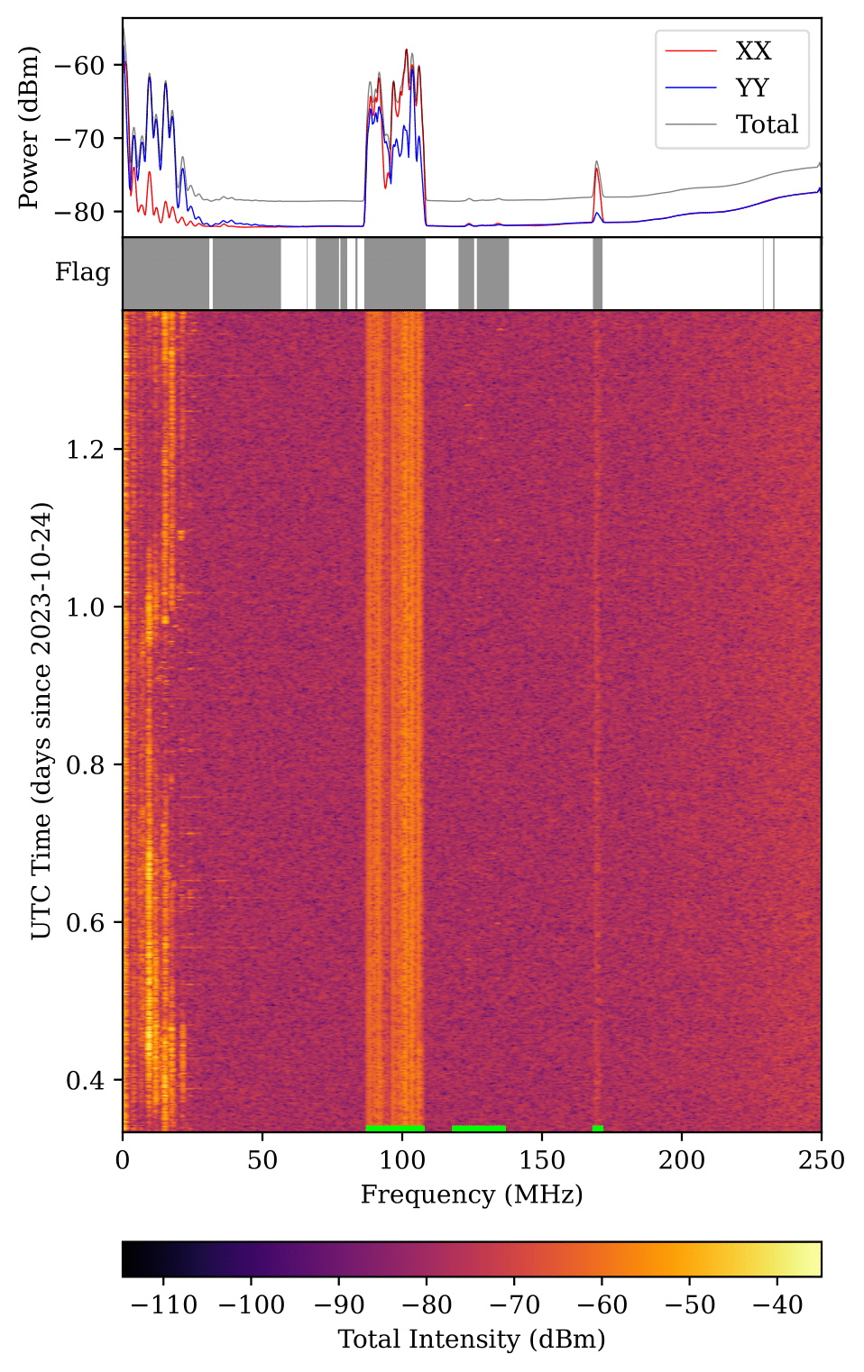
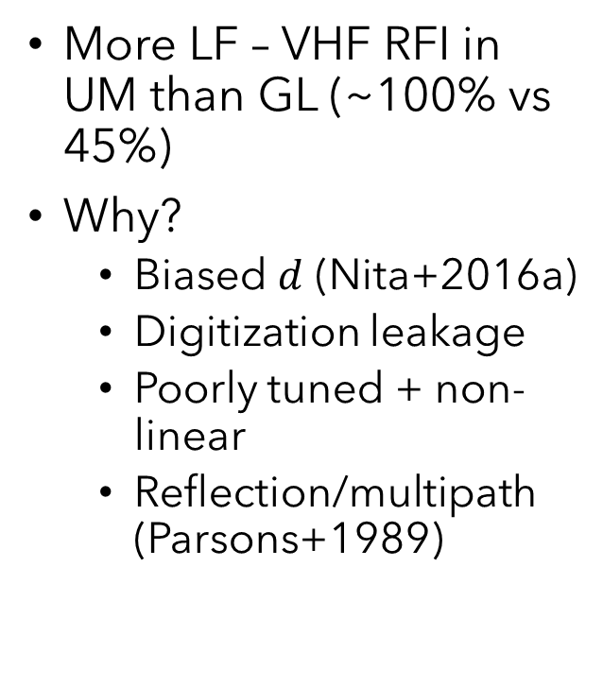
Results
More LF – VHF RFI in UM than GL (~100% vs 45%)
Why?
Biased $d$ (Nita+2016a)
Digitization leakage
Poorly tuned + non-linear
Reflection/multipath (Parsons+1989)
Overall RFI monitoring and SK flags for UM data (left) and GL data (right).
Notes:
Higher flagging percentages as expected in UM data compared to GL
Other then the natural results of higher sources of interference in urban environments, we suggest other potential reasonings
Mathematically, a biased SK shape factor can increase the false flagging percentage, but we can put that aside as we are using the median instead, there can be physical reasons
Strong narrowband signals can leak into neighbouring channels after digitization
Poorly tuned electronics can cause non-linear intermodulation which produce harmonics and intermediate terms at other frequencies, and therefore mimic a broadband interference
Reflections and multipath propagation can then modify radio emissions just like the intermodulation but with a more continuous effect

Slide 12

Discussion
Spectrum Allocation
Two types of RFI
Persistent (Duty cycles $≳50 \%$)
RFI-P1: 0 – 31.25 MHz
RFI-P2: 86.43 – 108.40 MHz
RFI-P3: 168.21 – 171.63 MHz
Transient (Duty cycles $≲50 \%$)
RFI-T1: 32.23 – 56.64 MHz
RFI-T2: 120.12 – 138.18 MHz
Compared with ITU and MCMC 2022
Overall RFI monitoring and SK flags for GL data.
Notes:
Second part of the results and discussion focuses on categorizing the RFI groups that we see, compare them with spectrum allocation, and to characterize any physical phenomena based on the patterns
Split the RFI groups into two types: Persistent i.e. RFI signals with a high duty cycle, and Transients i.e. signals with duty cycles less than 50%
Compare with the ITU Spectrum Allocation document and the Malaysian Communication and Multimedia Commission Spectrum Allocation 2022 document

Slide 13
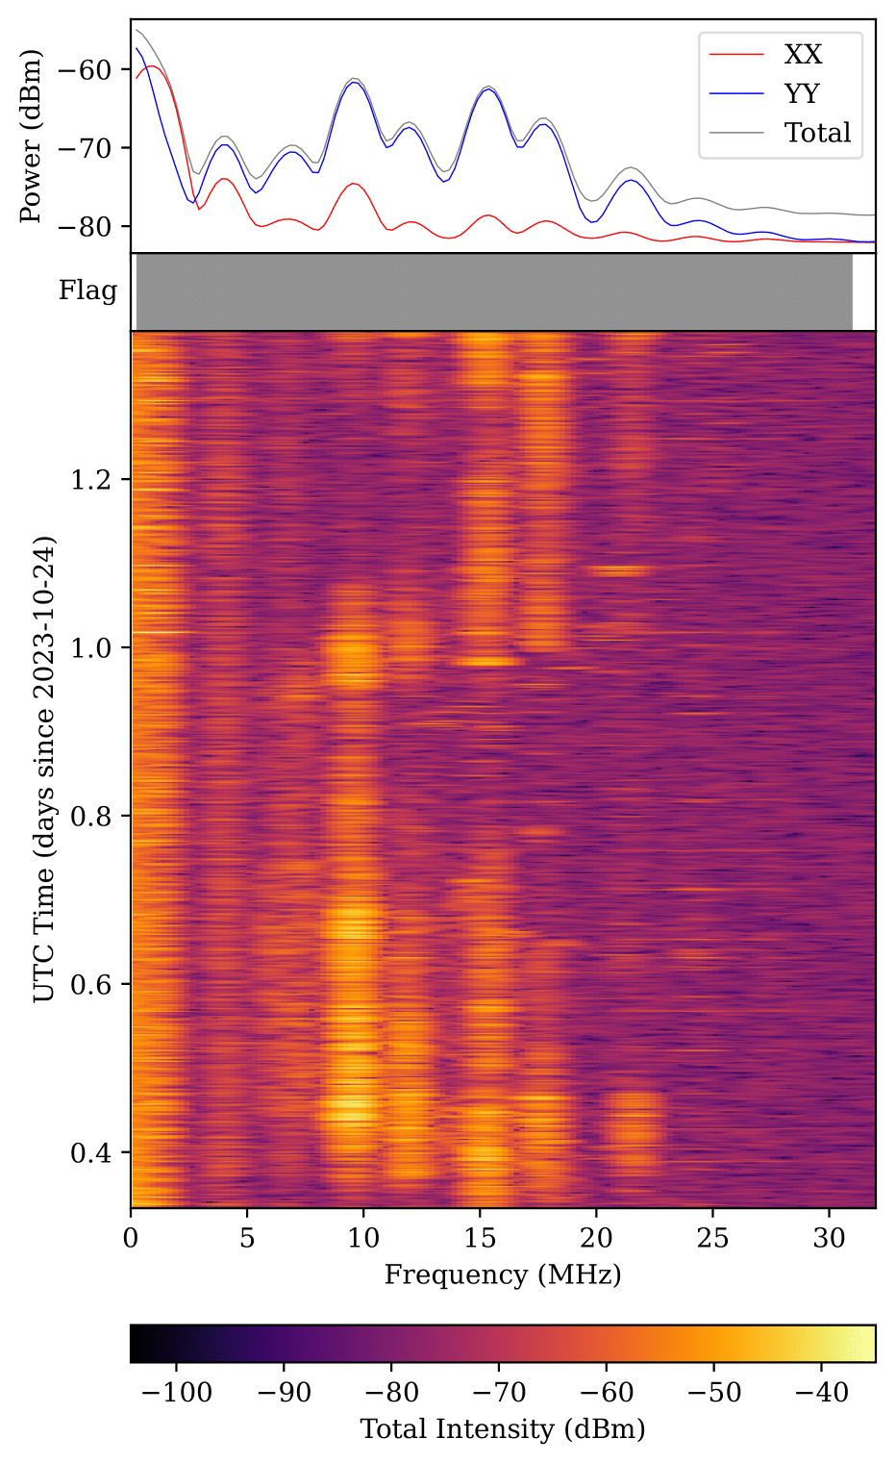
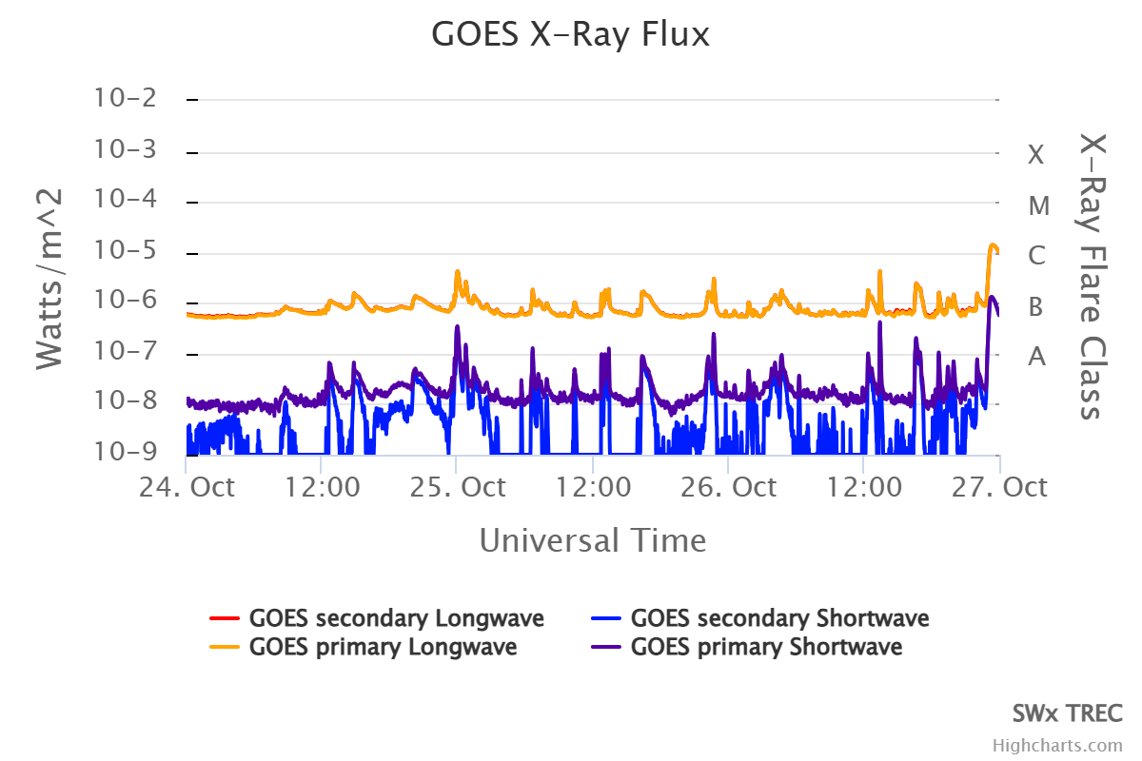
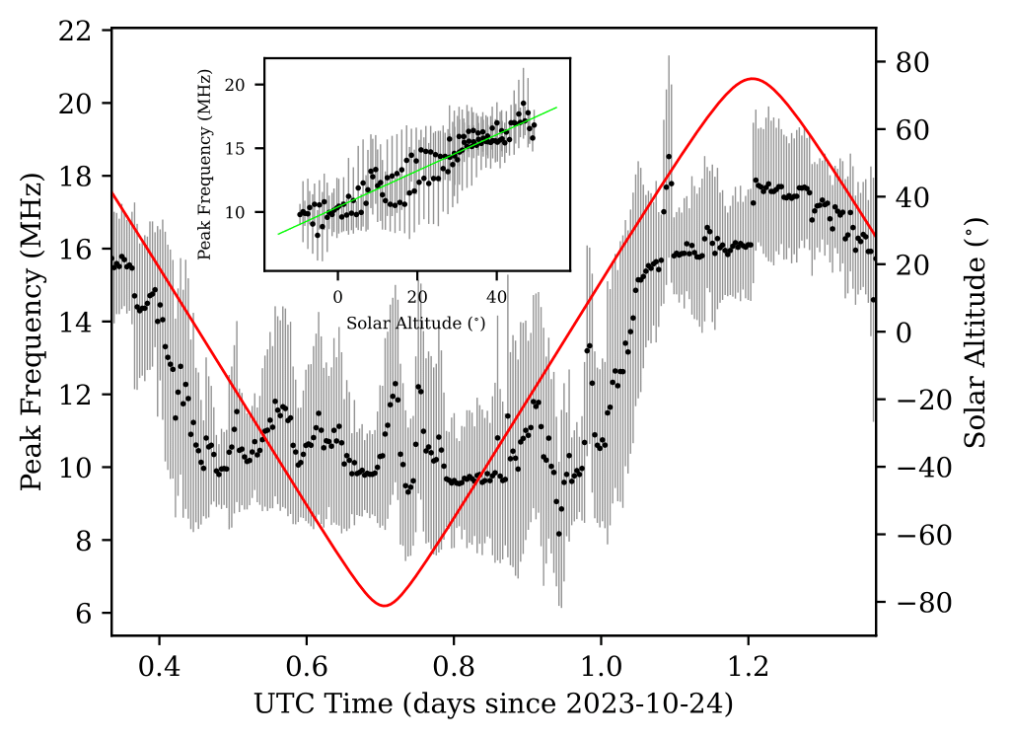

Discussion
RFI-P1 (0 – 31.25 MHz)
Various allocations
RFI-P1a (< 5 MHz): Consistent, direct + ground-reflected waves
RFI-P1b (> 5 MHz): Diurnal pattern due to skywave propagation
$f_{peak}∝α$, solar radiation enhances D layer, more opaque to low-$f$
Small disturbances either solar-induced and/or of atmospheric origin
RFI plot for RFI-P1 in GL data.
Notes:
RFI-P1: 0 – 31.25 MHz
Range allocated to various uses including mobile services, broadcasting, maritime, and amateur use
Can also further divide into two
Signals below 5 MHz has consistent emission over the entire day, only via direct propagation and ground-reflected waves, which is why the emissions are relatively stable, but in contrast, signals above 5 MHz has a pattern that changes over time
Compare peak emission frequency with solar altitude *** and we found a very strong positive correlation
Signals below 35 MHz are usually dominated by skywave propagation i.e. radio signals reflecting off the ionospheric E layer, which in communications allows for signals to travel much further without the blocking due to Earth’s curvature
The diurnal nature comes in when the Lyman-alpha and X-ray solar radiation during daytime ionizes the ionospheric D layer, making it more opaque to low-frequencies, so only high-frequency signals pass through and gets reflected; at night, the D layer thins and the opposite effect is achieved
Notice the small-scale disturbances that are seen in the data, *** able to match multiple class-C solar flares, which suggests that deviations in the diurnal data are indeed solar-induced

Slide 14
Discussion
RFI-P2 (86.43 – 108.40 MHz)
Allocated to mobile services (ITU Region 3: 87 – 108 MHz)
Occupied by FM radio broadcast, seen in Malaysia and neighbouring countries
RFI-P3 (168.21 – 171.63 MHz)
Allocated to mobile services (ITU: 162 – 174 MHz)
Allocated to Malaysian Government (MLA14: 169 – 173.50 MHz)
Overall RFI monitoring and SK flags for GL data.
Notes:
RFI-P2: 86 – 108 MHz
Range allocated to mobile services, mainly occupied by FM analogue radio broadcast, similar to other monitorings in Malaysia and the rest of Southeast Asia
RFI-P3: 168 – 171 MHz
ITU designates to mobile services, but in the Malaysian spectrum allocation it is allocated to the Malaysian government

Slide 15
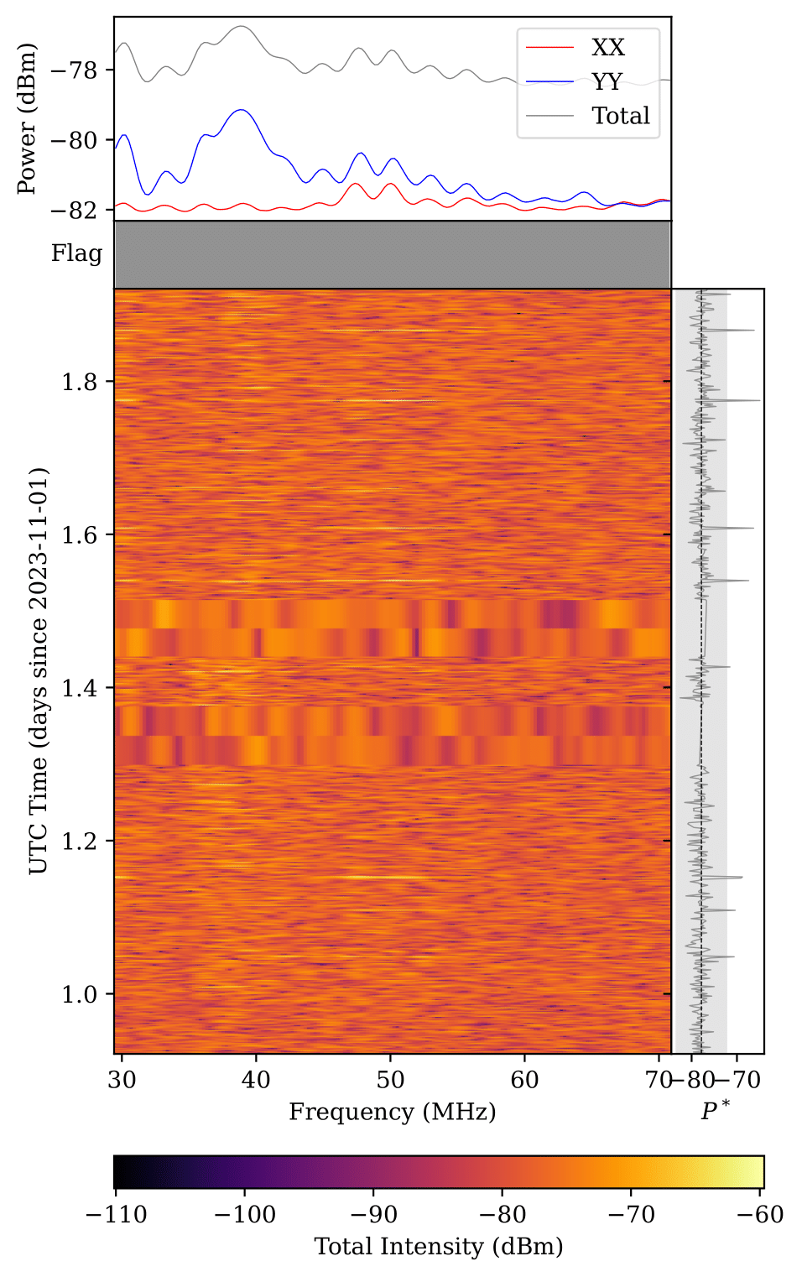
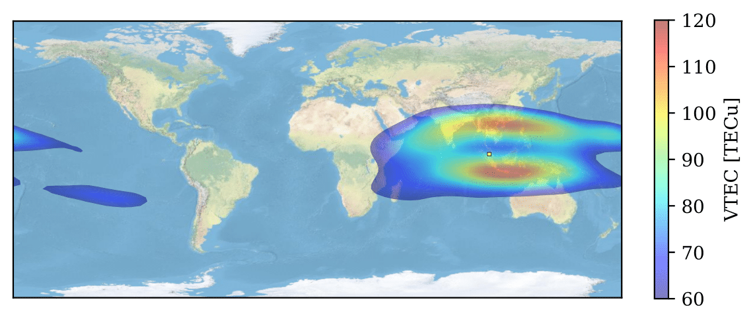
Discussion
RFI-T1 (32.23 – 56.64 MHz)
Various allocations
New VHF digital comm. at 50 MHz, EIA augments skywave propagation (e.g. Balan+2018)
RFI-T2 (120.12 – 138.18 MHz)
Allocated to aeronautical mobile services (ITU: 117.825 – 137 MHz) and emergency communications (ITU 5.200: 121.5 – 123.1 MHz)
RFI plot for RFI-T1 in UM data.
Notes:
RFI-T1: 32 – 57 MHz
Various uses based on spectrum allocation
Interesting feature in UM data: Transient signals at 50 MHz with width of 10 MHz
Suggested as a new VHF digital communication radio emission, previously unused due to inefficient skywave propagation
But presence of electrons may augment the propagation of such signals, *** checking VTEC maps, southern hump of the equatorial atmospheric anomaly traverses over Malaysia when the signals are present
RFI-T2: 120 – 138 MHz
Allocated to aeronautical mobile services or airband, also designated to aeronautical emergency or distress communication in all regions

Slide 16
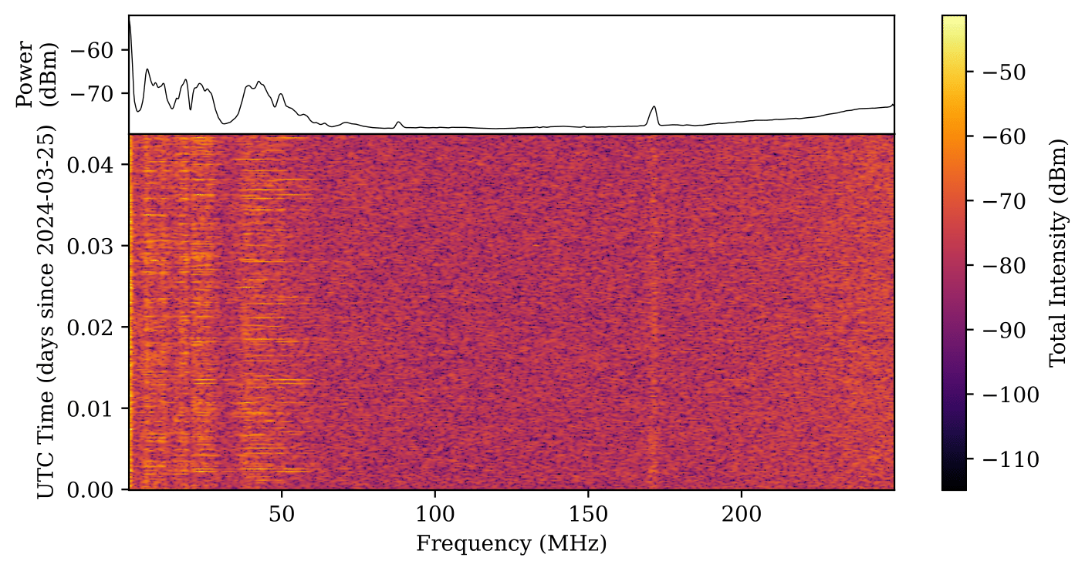
Discussion
RFI ID | Freq. (MHz) | Allocation | Notes
RFI-P1 | 0 – 31.25 | Various | Constant direct/ground-wave (P1a) and diurnal skywave (P1b) propagation
RFI-P2 | 86.43 – 108.40 | Mobile, broadcasting | FM radio broadcast
RFI-P3 | 168.21 – 171.63 | Mobile | Malaysian Government
RFI-T1 | 32.23 – 56.64 | Various | VHF augmented by EIA
RFI-T2 | 120.12 – 138.18 | Aeronautical | VHF-AM ATC
Spectrum Allocation
RFI Mitigation Methods
Post-Observation
MAD
Autocleaning (DWT)
Machine Learning*
Physical RFI Suppression
Frequency filters (Band stop, adaptive*)
Spatial filtering (DOA*, VLBI*)
1-hour RFI monitoring at UM using the band stop filter targeted on RFI-P2
Notes:
Summary of spectrum allocation comparison
The next section of the paper discusses about RFI mitigation techniques, not going to go through in detail, just briefly mention
For post-observation methods, we tested out two methods: Median absolute deviation (MAD) filtering as well as autocleaning using discrete wavelet transforms (DWT)
Also discussed on literatures regarding machine learning methods to mitigate RFI
For physical RFI suppression, we tested out frequency filters, specifically using a simple band stop filter targeted at RFI-P2, see positive results in a short monitoring test
Also discussed on adaptive frequency filters which can estimate and filter the RFI waveform continuously, as well as on spatial filtering using direction of arrival techniques and naturally using cross-correlation VLBI data which emulates local RFI spatial filtering
Overall, best method would be to combine both spatial suppression and post-observation mitigation techniques

Slide 17
Summary
arxiv.org/abs/2505.19372
Report 1-day RFI monitoring at UM (reference) and GL (RNZ candidate) using GSK to detect RFI: Stronger RFI in UM
3 persistent + 2 transient RFI detected: Matches spectrum allocations, RFI-P1 exhibit diurnal pattern due to skywave propagation, RFI-T1 potentially augmented by EIA
Next steps: Longer observations, wider frequency range and more locations
Nazri, A. A., Abidin, Z. Z., Mat Sabri, M. R., Rosli, Z., Hassan, M. S. R., … Dong, L. (2025). Temporal variability in low-frequency radio interference: Insight from high-cadence monitoring at a candidate radio notification zone in Malaysia. Advances in Space Research. doi:10.1016/j.asr.2025.05.035
Notes:
Next steps:
Year-round monitoring to capture longer term/seasonal variations in RFI
Wider frequency range to cover important radio astronomy frequencies (L, C, X, eventually Ku + K)
More locations to cover wider variation in environmental characteristics

Slide 18
Appendix

Slide 19
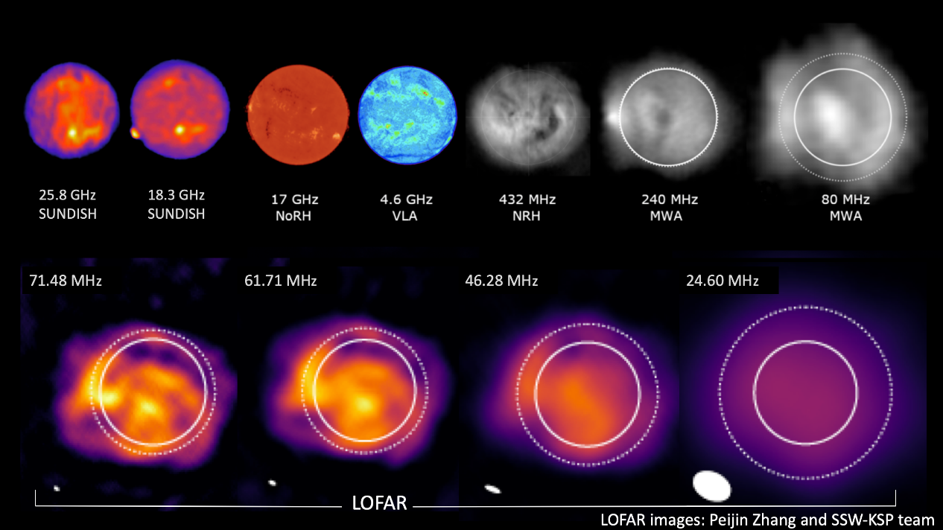

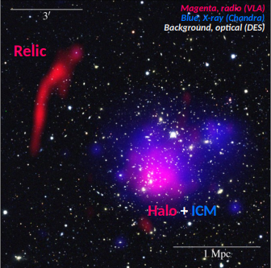
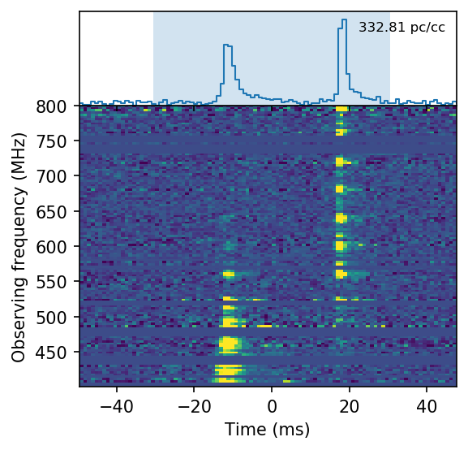

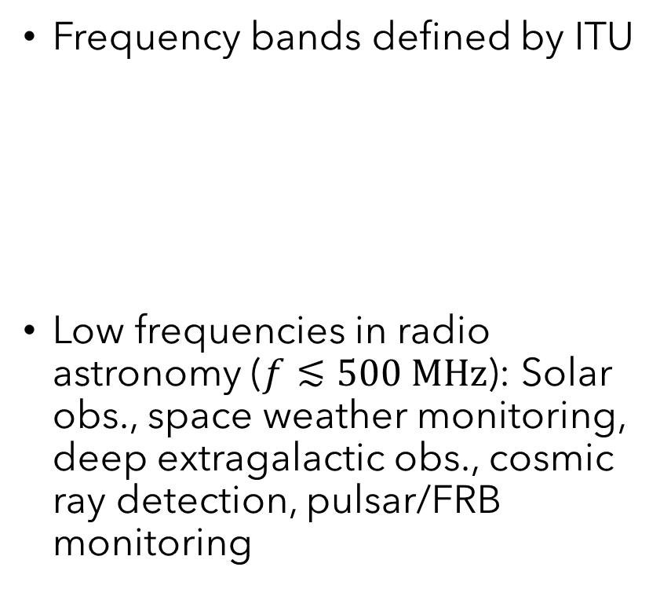
Appendix A: Low-$f$ Astronomy
Frequency bands defined by ITU
Low frequencies in radio astronomy ($f≲500 MHz$): Solar obs., space weather monitoring, deep extragalactic obs., cosmic ray detection, pulsar/FRB monitoring
Band | Frequencies
LF | 30 – 300 kHz
MF | 300 – 3000 kHz
HF | 3 – 30 MHz
VHF | 30 – 300 MHz

Slide 20
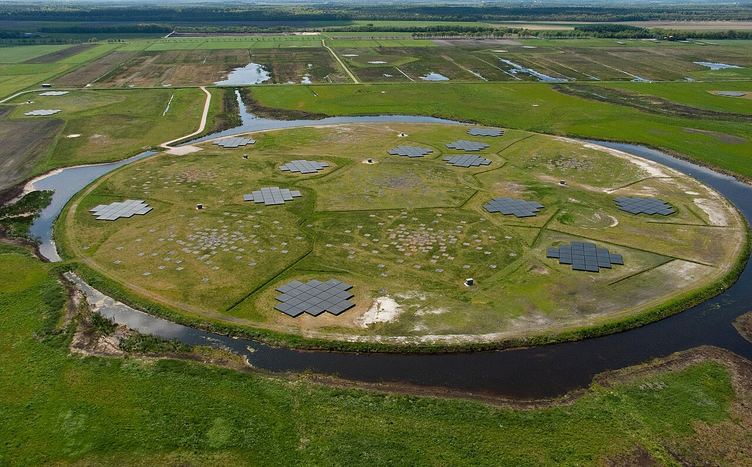
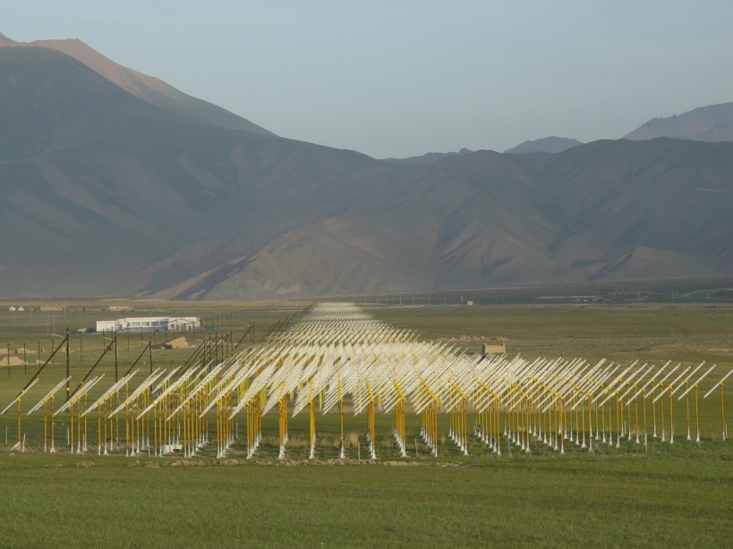


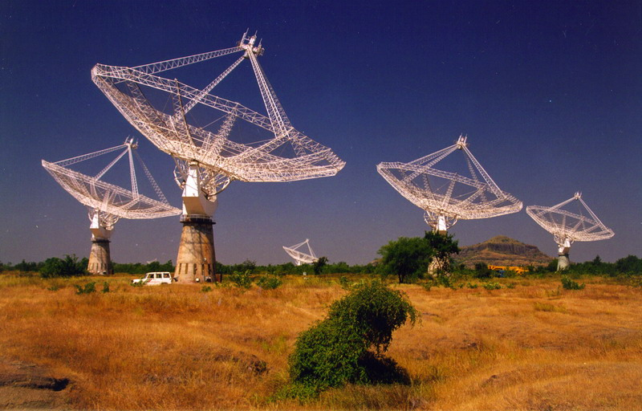
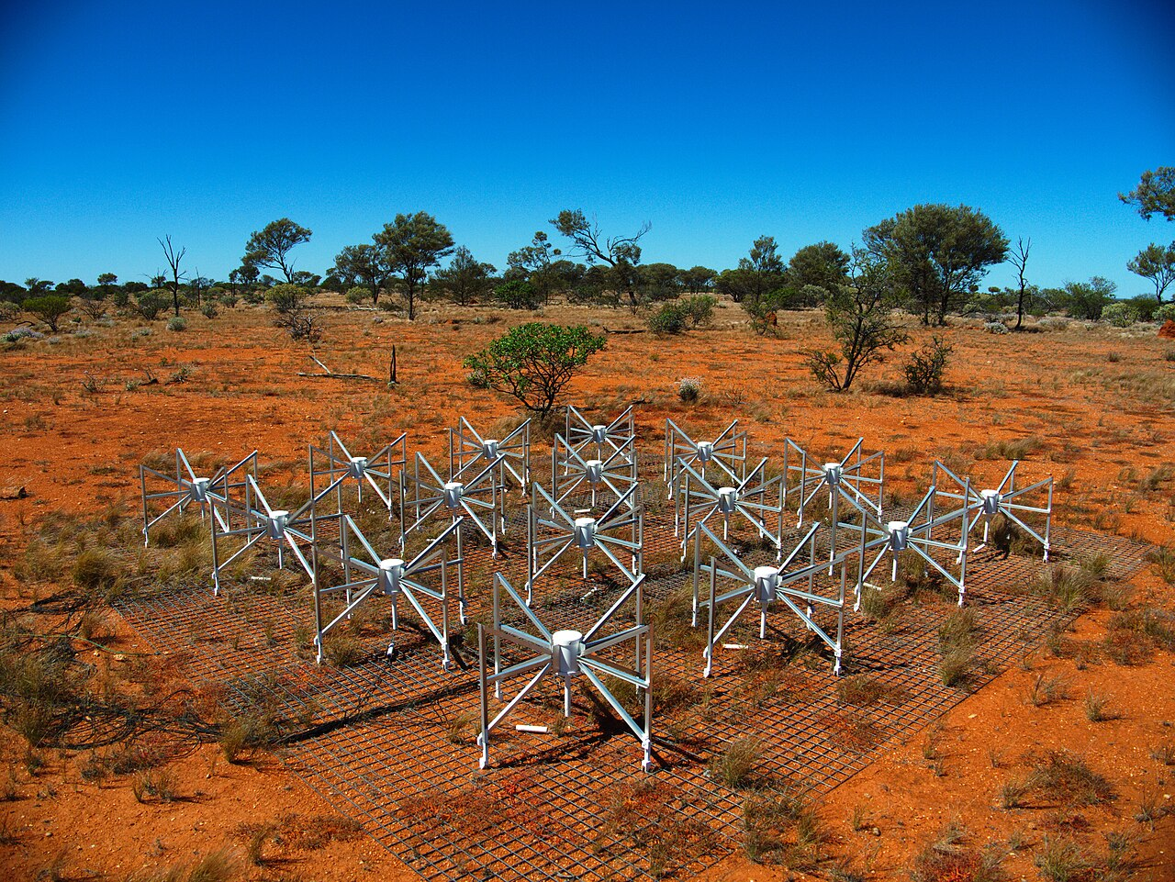
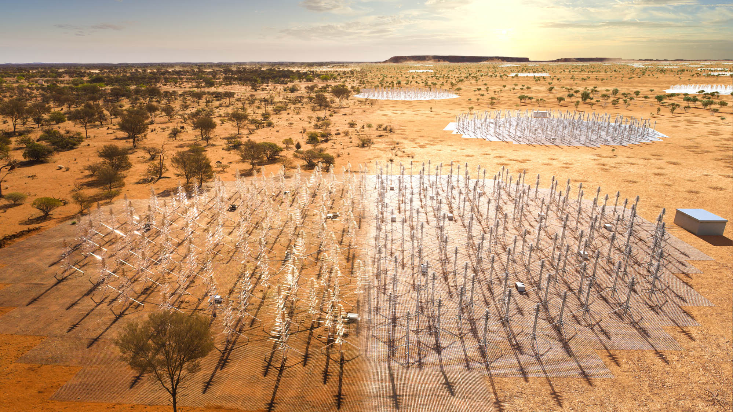



Appendix A: Low-$f$ Astronomy
Instrument | Frequencies
LOFAR | 10 – 240 MHz
21CMA | 50 – 200 MHz
GMRT | 150 – 1450 MHz
MWA | 70 – 300 MHz
SKA (low) | 50 – 350 MHz

Slide 21
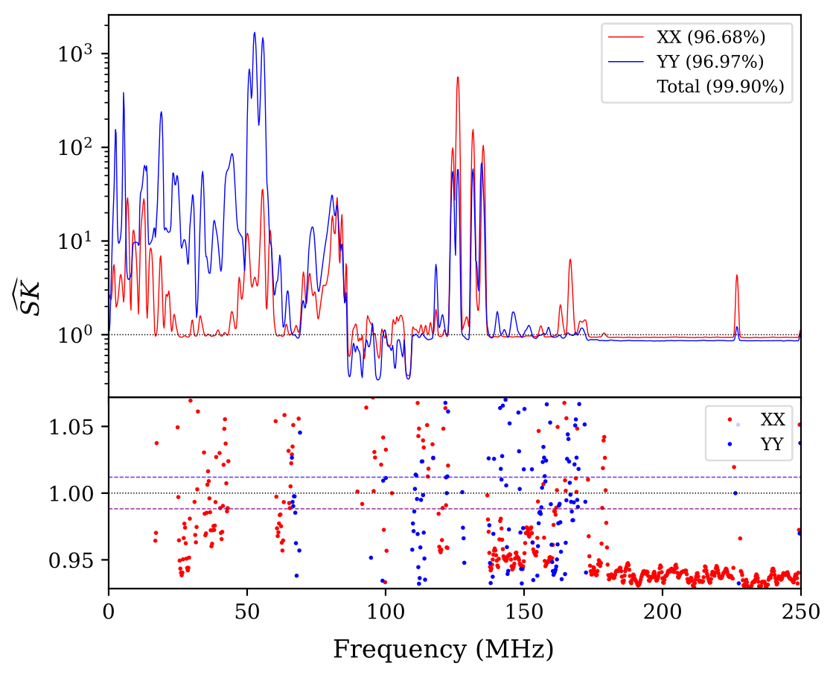
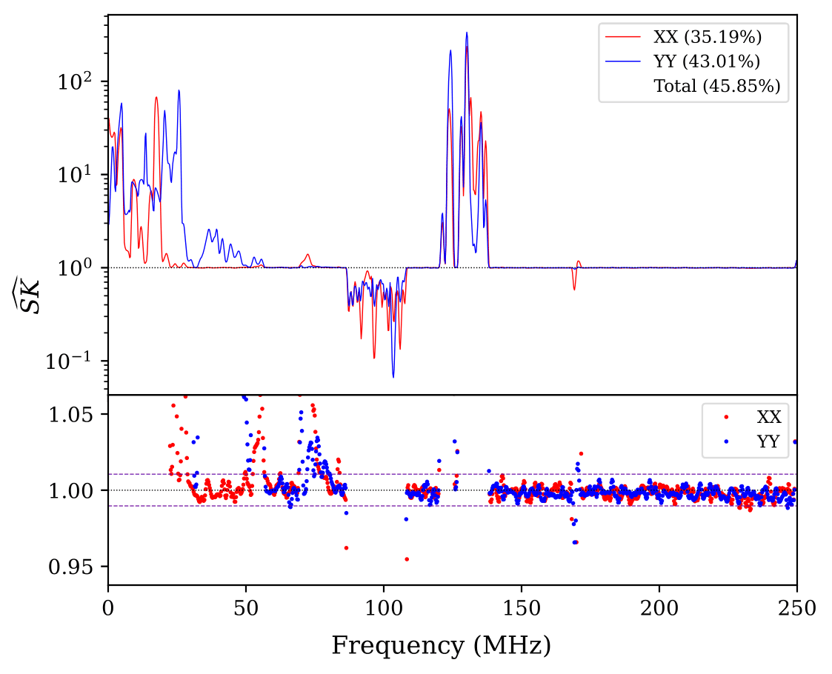
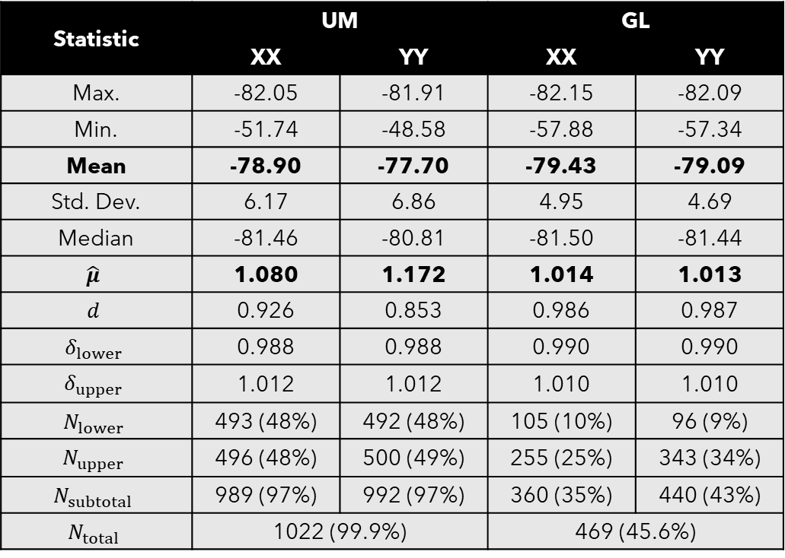
Appendix B: SK Statistics
Statistic | UM |  | GL
 | XX | YY | XX | YY
Max. | -82.05 | -81.91 | -82.15 | -82.09
Min. | -51.74 | -48.58 | -57.88 | -57.34
Mean | -78.90 | -77.70 | -79.43 | -79.09
Std. Dev. | 6.17 | 6.86 | 4.95 | 4.69
Median | -81.46 | -80.81 | -81.50 | -81.44
$$\hat{μ}$$ | 1.080 | 1.172 | 1.014 | 1.013
$$d$$ | 0.926 | 0.853 | 0.986 | 0.987
$$δ_{lower}$$ | 0.988 | 0.988 | 0.990 | 0.990
$$δ_{upper}$$ | 1.012 | 1.012 | 1.010 | 1.010
$$N_{lower}$$ | 493 (48%) | 492 (48%) | 105 (10%) | 96 (9%)
$$N_{upper}$$ | 496 (48%) | 500 (49%) | 255 (25%) | 343 (34%)
$$N_{subtotal}$$ | 989 (97%) | 992 (97%) | 360 (35%) | 440 (43%)
$$N_{total}$$ | 1022 (99.9%) |  | 469 (45.6%)

Slide 22
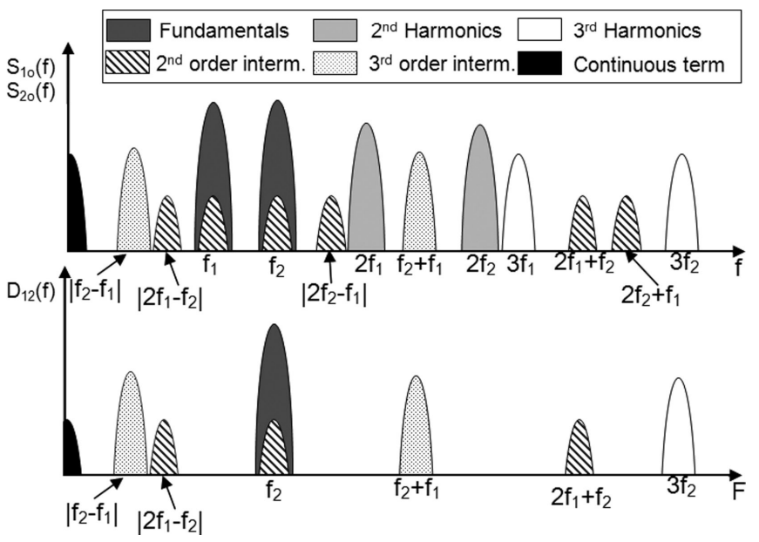
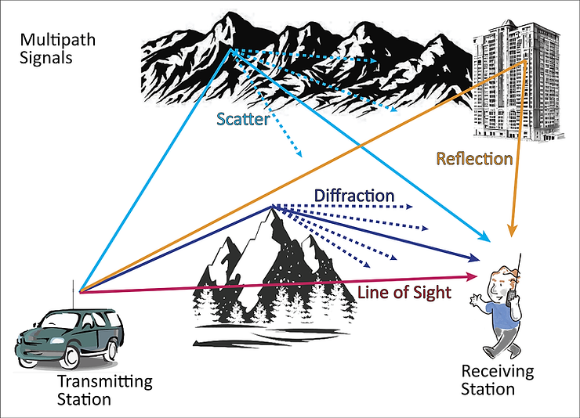
Appendix C: Harmonics + Intermodulation and Multipath Propagation

Slide 23
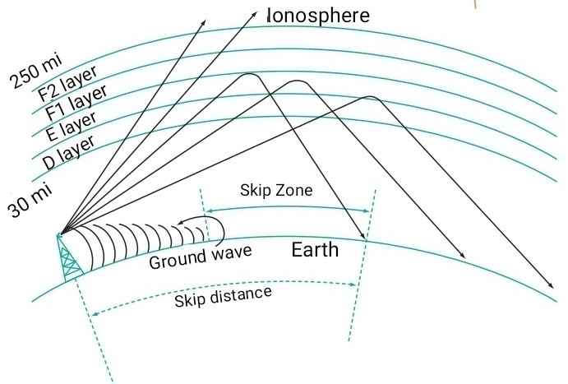
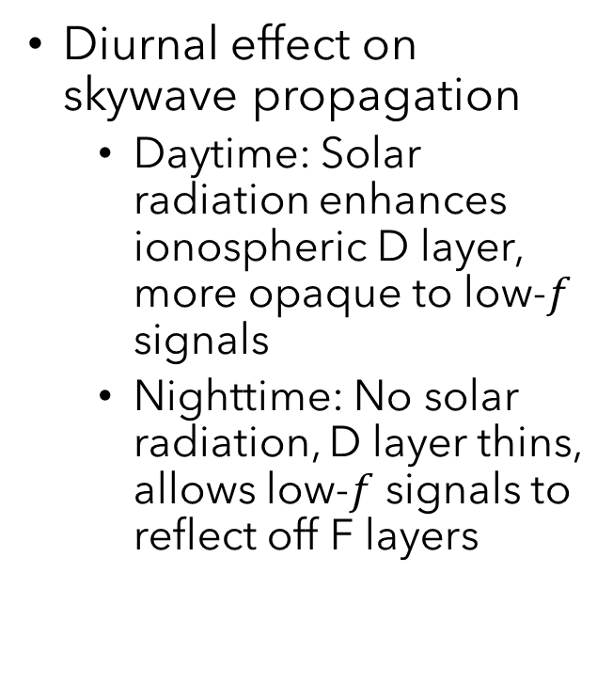
Appendix D: Skywave Propagation
Diurnal effect on skywave propagation
Daytime: Solar radiation enhances ionospheric D layer, more opaque to low-$f$ signals
Nighttime: No solar radiation, D layer thins, allows low-$f$ signals to reflect off F layers

Slide 24

Appendix E: RFI Mitigation Methods
Post-Observation Mitigation
MAD: Filter outliers using median deviation (Buch+2016)
Mitigates well, but overcorrected
Autocleaning: Estimate RFI waveform and subtract
DWT: Multi-level FFTs, effective in various cases (Camps+2009, Diez-Garcia+2019, Tian-qi+2021)
(3-level Haar) Detects all RFI, but undercorrected

Slide 25

Appendix E: RFI Mitigation Methods
Physical Suppression
Attenuate based on priori RFI information
Band stop filter with 50 dB attenuation targeted at RFI-P2 (86.43 – 108.40 MHz) with 76 – 122 MHz roll

Slide 26

Appendix F: RFI Monitoring Project
Create low-cost remote RFI measurement device
Place stations all around Malaysia
Automatically send data to a central server
Gather ~ 5 year dataset
Compare with neighbouring countries
Analyse persistent, transients, and seasonal variation

Slide 27


Appendix X: Water Masers in RCW142
RCW142: SFR in Galactic bar with complex maser/radio/IR properties
KaVA water maser data for 3D kinematics
Methodology:
Data Calibration: AIPS + ParselTongue
Imaging: AIPS (IMAGR), very extended – Solved with iterative imaging based on Asanok+2023
Absolute position correction: VERA dual-beam inverse phase-referencing based on Imai+2012, Burns+2015
Maser spot detection & feature grouping: Automatically using PyBDSF, DBSCAN, Graph

Slide 28



PRELIMINARY RESULTS

